Slide 1
GE-PS
Golden Eagle Parking System
CS 3337 - Software Engineering
May 2020
Prepared by
Kevin Diaz-Lopez
Phoebe Castanedo
Angie Alvarez

Slide 2
Introduction

Slide 3
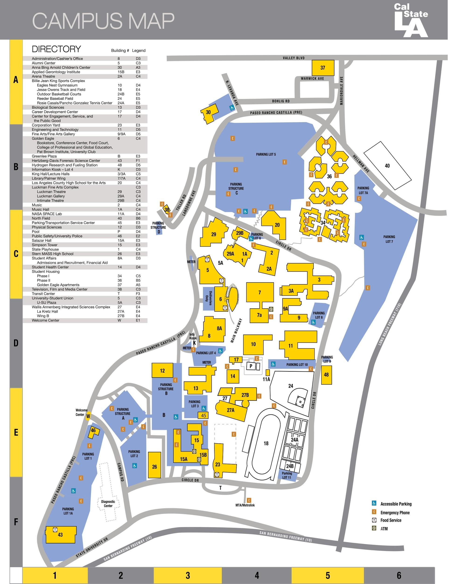
What is GE-PS?
an Android app aimed at streamlining visits to CSULA via monitoring of parking lot availability
achieves this through image processing
contains QoL features such as auto-recommendation and tagging of your parking space

Slide 4
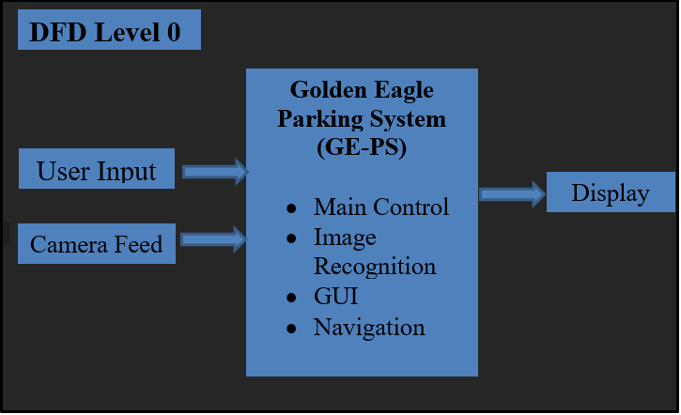
DFD Level 0

Slide 5
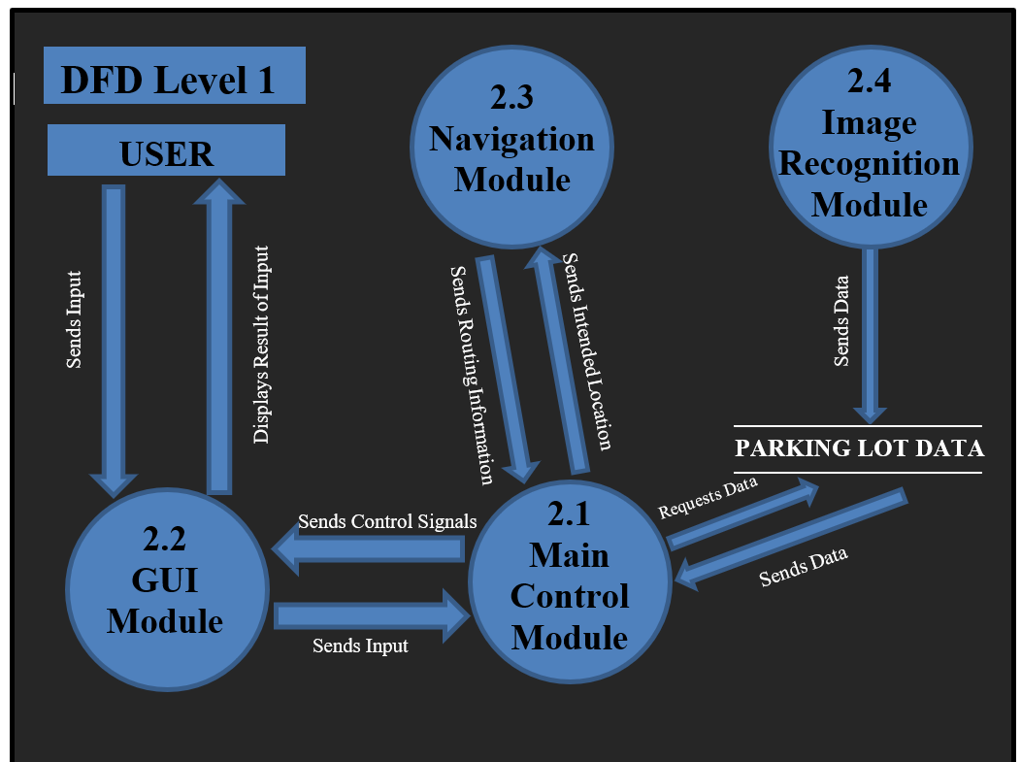
DFD Level 1

Slide 6
Module Descriptions

Slide 7
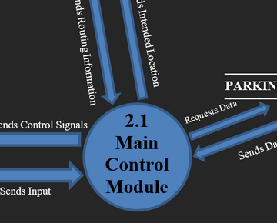
Main Control Module
(module 2.1)
The Main Control Module, or MCM is the module responsible for all flow of data within GE-PS. Its responsibilities include storing user preferences, sending parking lot data for display on the main GUI, and communicating routing information with the Navigation module (such as intended user location). It works very closely with the GUI.
Notes:
The main control module is the module responsible for all flow of data within GE-PS.
It stores user preference, sends the parking lot data to be displayed on the main GUI, and also communicates routing info with the navig module.

Slide 8
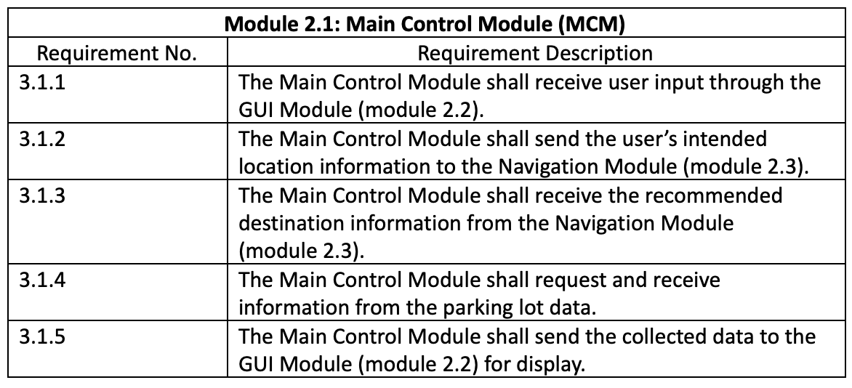
Main Module Requirements
Notes:
Receives location data of the user from their cell phone GPS.
Send location data of the user to the nav module.
Main Module will also, send a request to open an external routing app if the user if out of range of GE-PS.
MM should also recieve updates from the parking spot database as often as chosen by the user.
Shall send parking space data to the GUI for display.

Slide 9
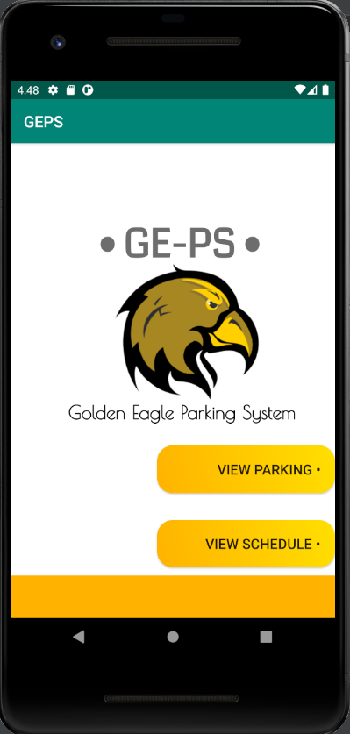
GUI Module
(module 2.2)
The GUI Module is the frontend of GE-PS.
The main screen is a simple welcome screen as seen to the right. From here the user may choose to view the parking lots immediately, or view their schedule and get auto-recommendations.
Notes:
So our main screen has a simply layout, where the user can chose to view the parking lots directly or they can chose to input their schedule and utilize an auto-recommendation feature based on that input.

Slide 10
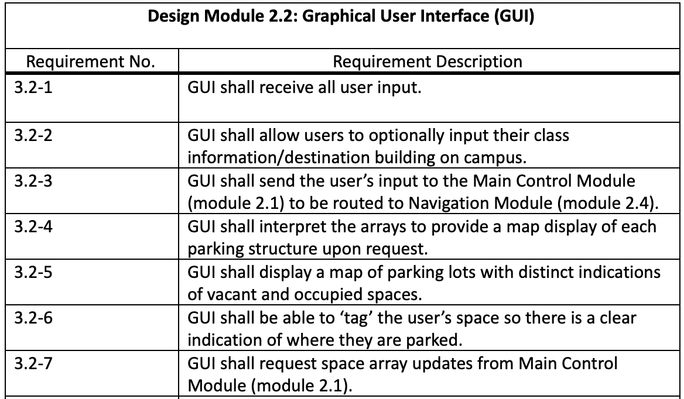
GUI Module Requirements

Slide 11
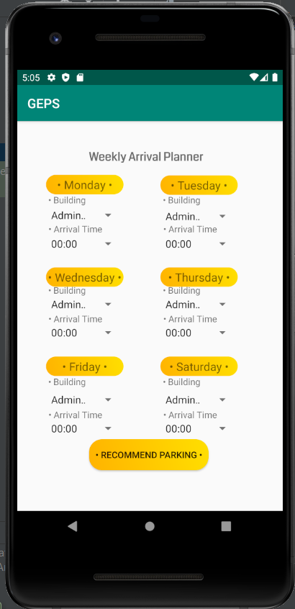
Navigation Module
(module 2.3)
The Navigation Module is responsible for the auto-recommendation of parking spots and routing of the user to their spot, given access to their devices’ GPS.
Due to time constraints the routing portion of this module was not implemented, however its auto-recommendation and scheduling features are.

Slide 12
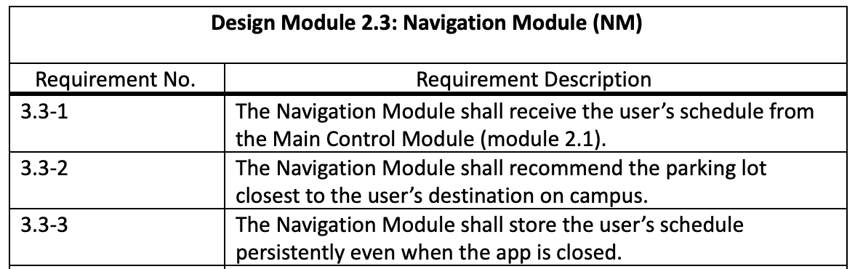
Navigation Module Requirements

Slide 13
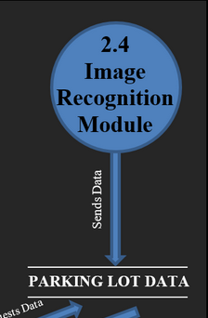
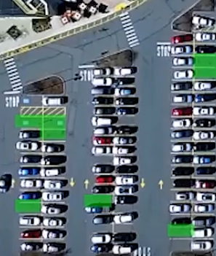
Image Recognition Module
(module 2.4)
Finally, the Image Recognition module is one of the most important modules of GE-PS as it is responsible for all image processing that allows the camera feed of a parking lot to be interpreted into either occupied or vacant spaces.

Slide 14
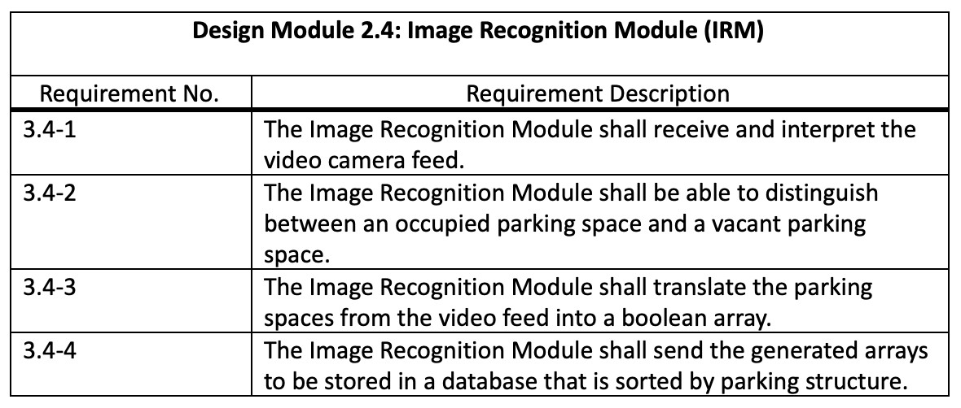
Image Recognition Module Requirements

